Slide 1
SEPTA the way to go BACK

Slide 2
COVID-19 RESPONSE Safety and security of is SEPTA’s top priority
SEPTA never stopped operating
Masks are required on SEPTA, even for vaccinated riders
Enhanced cleaning and air purification
Hiring 200 additional cleaners
PPE, Testing & Temperature Screening for all employees4,500 SEPTA employees are already vaccinated

Slide 3
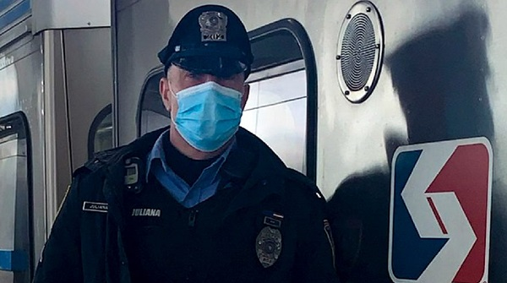
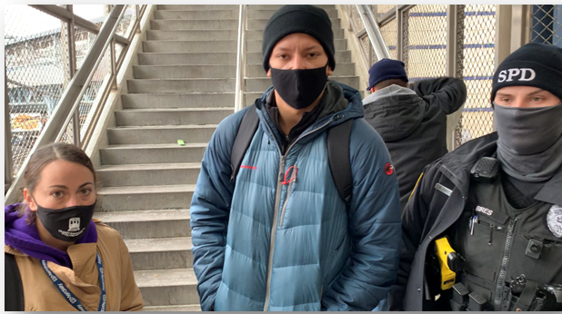
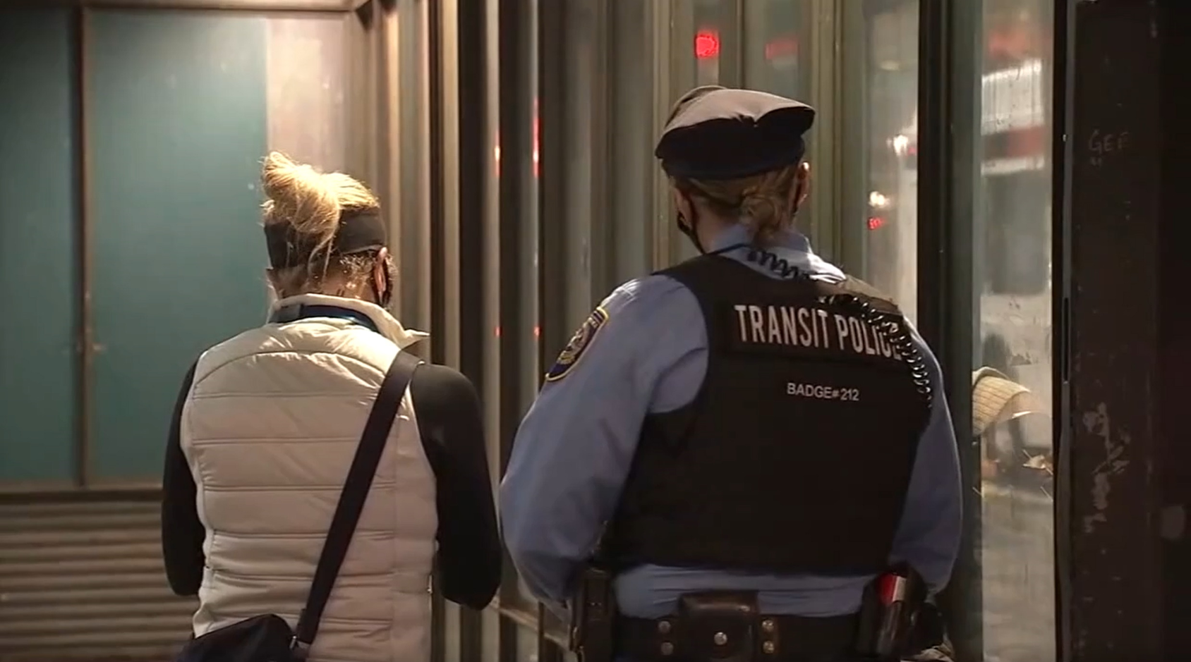
COVID-19 RESPONSE Vulnerable Populations Action Team
Community partnerships
Increased the number of outreach workers paired with SEPTA Transit Police
Since October 2020
514 interactions
446 engagements only
62 resulted in referrals
6 resulted in admission to a facility.
Contracted with security firm for guards at Market-Frankford Line Stations
SEPTA Vulnerable Population Action Team

Slide 4
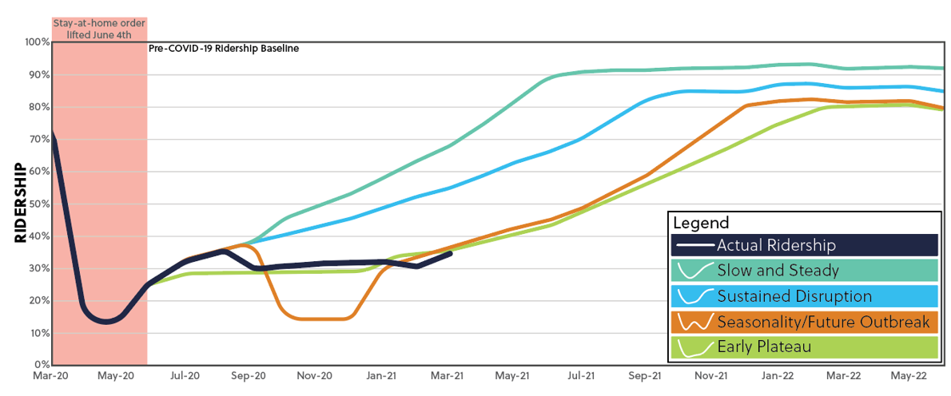
COVID IMPACT:
Ridership
Ridership Projections through FY 2022
Estimate; subject to change
Estimate; subject to change

Slide 5
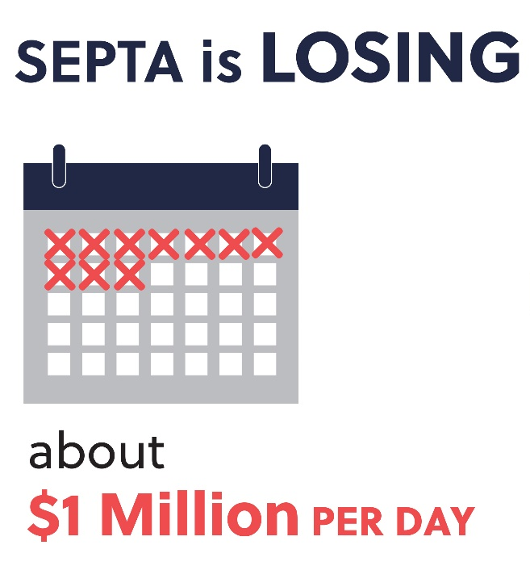
COVID-19 IMPACT:
SEPTA Capital Budget Crisis Continues
Decline in Ridership and Farebox revenues impacts SEPTA’s Operating Budget
SEPTA is losing $1 million every day
Federal COVID aid supports SEPTA operations
Will cover operating shortfalls
Will keep fares low
Federal aid runs out before ridership and farebox revenues rebound and budgets rebalanced
Seeking long-term federal funding for transportation, infrastructure investment
Uncertainty of Act 44/89 Deadline Created a Capital Budget Crisis
SEPTA proposed 2 capital budget plans – one without payments after July 2022
$4.6B Vehicle and Infrastructure SOGR backlog + projects of regional significance
Seeking adequate, sustainable, bondable state funding and local/regional investment
Cost Cutting and efficiencies will continue

Slide 6
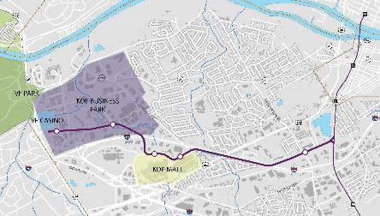
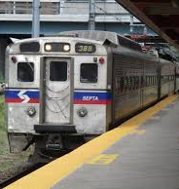
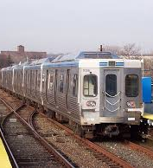
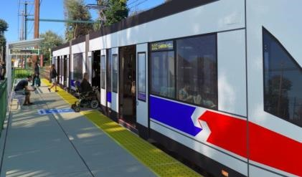
SEPTA MUST KEEP MOVING FORWARD…
With Increased Investment SEPTA Can Advance Projects of Regional Significance
SEPTA FORWARD: BUS REVOLUTION
KING OF PRUSSIA RAIL
VEHICLE REPLACEMENT (REGIONAL RAIL & MFL)
TROLLEY MODERNIZATION

Slide 7
2021 – A CRITICAL Year
Transportation is not a cost; it is an investment that will accelerate recovery, and promote inclusive economic growth, equity and the environment.
Legislative action is needed to:
Pass Federal reauthorization and infrastructure investment
Secure sustainable, bondable State funding
Provide Local governments the ability to generate revenues and invest in projects of regional significance.

Slide 8
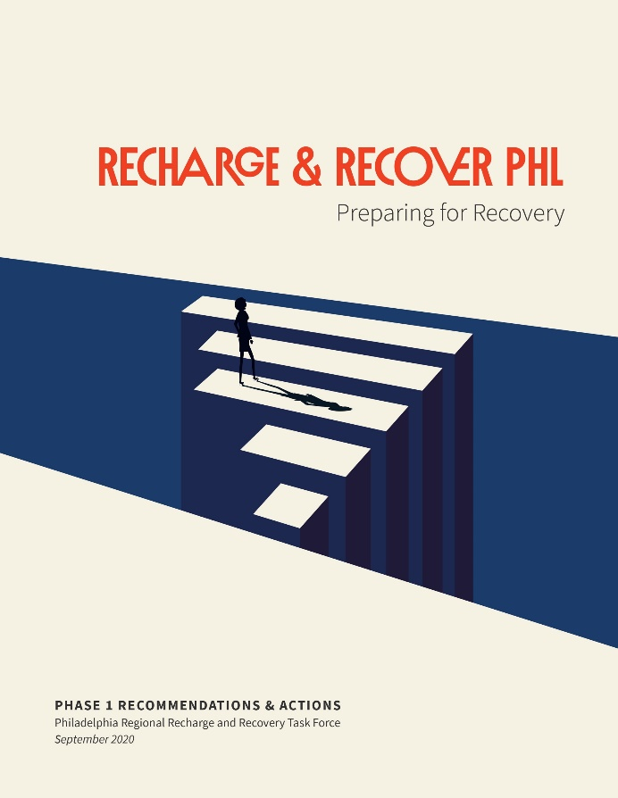
SEPTA PARTNERSHIPS
Regional Recovery Initiatives and Employer Toolkit

Slide 10
SEPTA the way to go BACK

